Slide 1


Online Quiz Management System
Second Review 27.10.2020
Rishi Dinesh 19BAI1009
Pranav Balaji 19BAI1151

Slide 2

INTRODUCTION
The process of conducting a manual examination is tedious and time-consuming. Various online quiz management systems (QMS) have been developed to overcome this hurdle.
Many institutions are also focusing on developing web-based virtual classrooms as an interaction place between the students and the teachers.
This setting is useful not only in long-distance based learning but also in conventional classrooms, in the sense that these online web applications can also serve as a supplementary learning tool in many institutes. However, these systems focus only on the teaching process.
Testing is an important part of any educational system. . In addition to the conventional tests in the classrooms, many situations may require testing systems such as testing application for a job opening and many more.

Slide 3
ISSUES ENCOUNTERED IN THIS DOMAIN
It was observed that there was a yawning gap between the E-Learning platforms and E-assessment platforms in terms of both quality and quantity
It was also found that most of the currently existing Quiz Management Systems (QMS) were usually found as an integrated part of bigger LMS.
There was also a lack of a widespread community for enthusiastic quizzers to share and attend quizzes to develop their skills.
A huge communication gap was present between the quiz organiser and the quiz taker owing to the lack of a two-way feedback system.
It was noticed that some of these systems had a rigid marking system i.e. features like negative marking and option-wise marking were absent.
Issues of network stability and quiz security.

Slide 4
OBJECTIVE - ISSUES TACKLED IN THIS PROJECT
This project focuses mainly on bridging the gap between the standards of LMS and QMS by developing an independent quiz website with built-in visibility modes and integrated group facilities that can help make the process of conducting and evaluating quizzes easy and efficient.
The lack of independent QMS raised the need to develop this project as a standalone system (as opposed to being a part of e-LMS). This can help build a platform where enthusiastic quizzers can create , share and attempt quizzes of various types.
It solves the problem of the lack of a more convenient and flexible grading system by introducing option-wise marking and negative marking in addition to an auto grading system.
The two-way feedback system can help bridge the gap between the quiz taker and the quiz organiser

Slide 5
Proposed Method

Slide 6
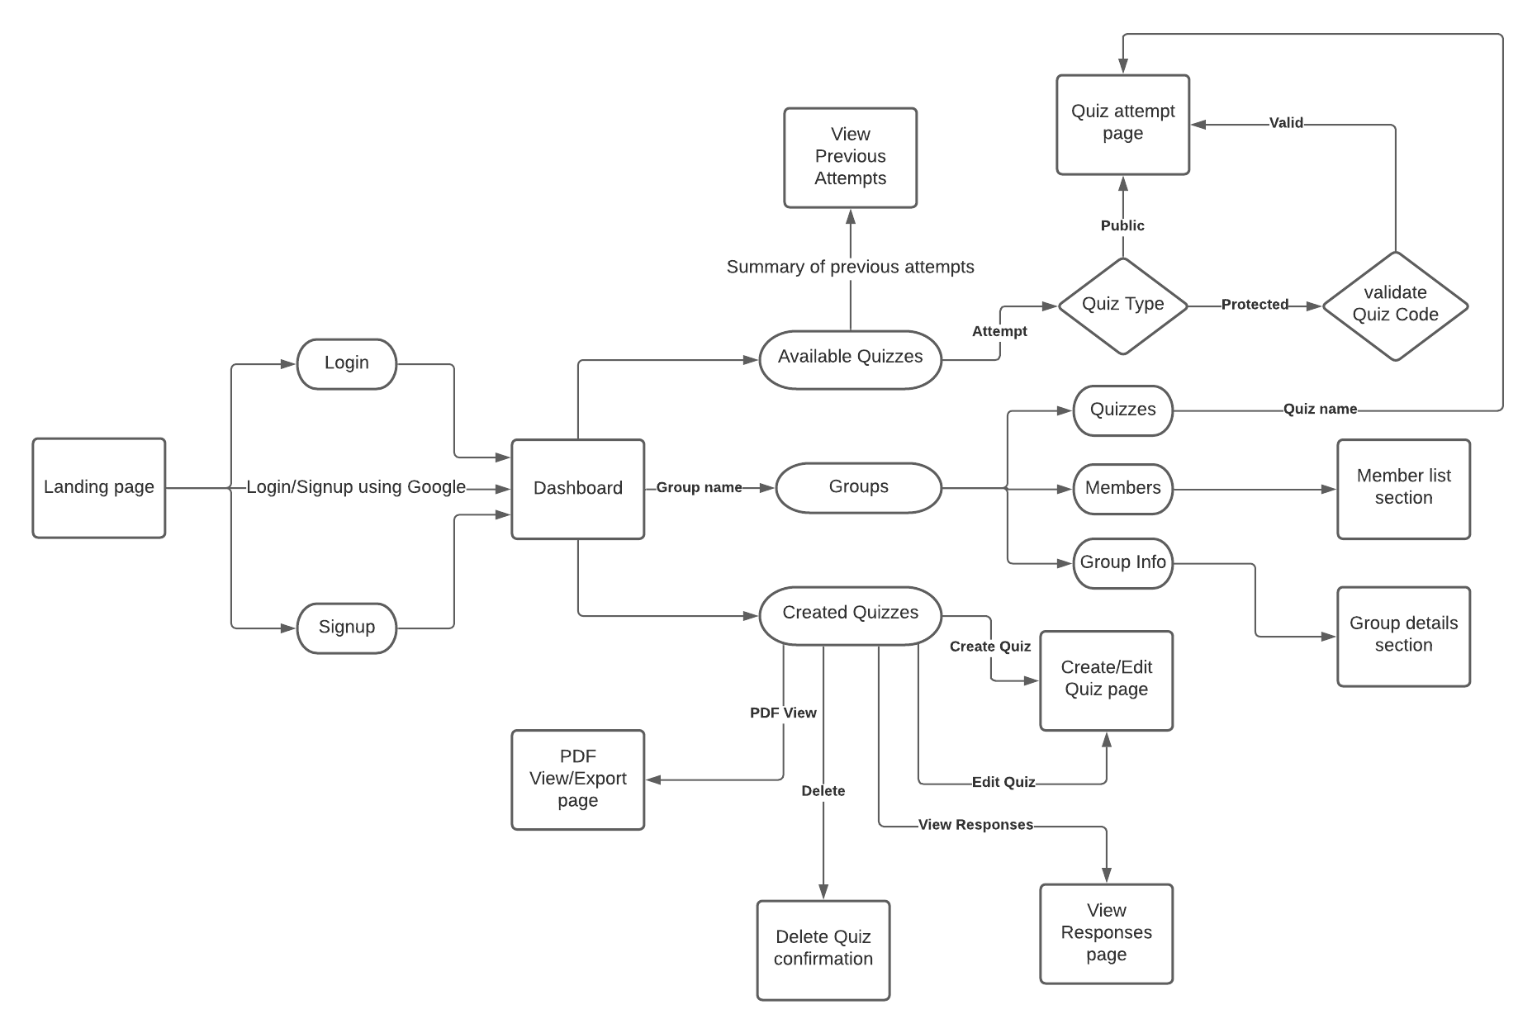
WEBSITE FLOW

Slide 7
Proposed System Architecture

Slide 8
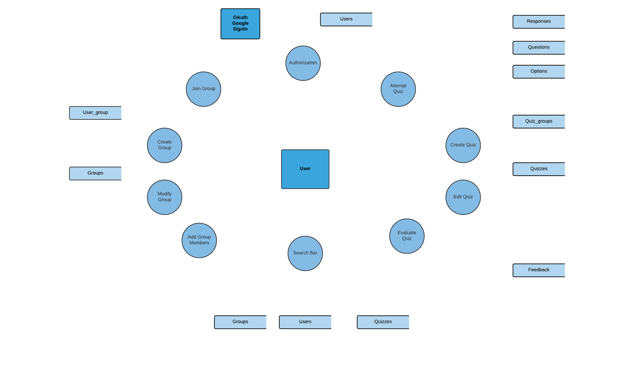

Slide 9
LIST OF MODULES
Authorization
Login and Signup
Oauth 2.0 login authentication
Quizzes
Create/edit quiz
Attempt quiz
View Responses/ Evaluation and feedback
View Quiz
Delete Quiz
Export Quiz
Groups
Create group
Add/Remove members
Transfer admin privileges
Add/Remove Quizzes
Edit group information
Delete group
Search bar

Slide 10
AUTHORIZATION
Account Creation
An account for the user can be created using a provided email address, first name, last name and a password, which is encrypted and stored in the database.
Multiple account creation using the same email address is prohibited, with login using third-party logins given an exception.
There are no limits and conditions on the type and structure of the input details, although protection against Injections are handled and taken care of.
User = {userId, uniqueUserId, firstName, lastName, email, password, loginType}
With the supplied information of firstName, lastName, email and password, a user is created in the database with an autoincrementing userId, a uniquely generated uniqueUserId which starts with the character ‘U’ followed by an octet of digits (CRC-32 random hash generation).
The loginType is an Enum, and in this case, takes the value of ‘LOGIN’ for Quizzee account creation and login. The password is encrypted using a combination of md5 and sha256 encryption algorithms. The uniqueUserId will be used to access the user in further necessities.

Slide 11
OAuth 2.0 Login Authentication
AUTHORIZATION
The user will be redirected to Google’s sign-in page, from where they can choose their account to login and proceed through the login procedure.
The authentication will be handled by Google’s servers and the result of the authentication will be fetched and the required fields will be taken for password-less account creation.
ALGORITHM:
Instantiate a new Google Client from the Client Application with the required scopes (Scopes refer to the data that is permissible to access by the application)
Call the Google server for an Access Token, which is a short-lived JWT that can authenticate a signed user.
Instantiate a Google Service which can retrieve information about the user from the Google Server using the Access Token – givenName, familyName and email.
Close the connection to the endpoint and create a new User with the same process as before in the database, with the login credentials from Google server and loginType set to be ‘GOOGLE’.

Slide 12
Create/ Edit Quizzes
QUIZZES
Algorithm
Create a quiz by supplying a Quiz Name
Choose the type of Quiz – Open, Code-protected or Group-restricted. The second option will provide a uniqueQuizId. The third option will prompt for the groups to add the Quiz to.
Clicking on the Add Question button will create a new blank question. It contains a Question Description and a prompt for selecting the type of question.
There are 4 types of questions – MCQ, MCMQ, TF and D.
For MCQ and MCMQ, the user will be prompted to create options, which also need the option description and the correct answer.
The D type questions will create a textbox for the attendee to enter the answer. The TF type questions create 2 options – True and False.
The quiz, questions and options will be generated in the above-specified format and stored in the database so.
Creation of Quizzes is designed to have a very simple interface that involves minimal manual work from the user’s end.
Quiz = { quizId, uniqueQuizId, quizName, quizType, quizCode, createTime, creatorId }
Question = { questionId, questionNumber, questionDescription, questionType, quizId }
Option = { optionId, optionNumber, optionDescription, optionIsAnswer, optionWeightage, questionId }

Slide 13
Attempt Quizzes
QUIZZES
A Quiz can be attempted by anyone (constrained by the abstraction) except the Quiz creator.
The Quiz can be attempted freely (Open), after supplying Quiz Code (Code-protected) or being in a group (Group-restricted) by the attendee.
Response = {responseId, attemptNumber, userId, quizId, questionId, optionId, responseText?, responseWeightage, attemptTime}
Algorithm:
Authorization of User and user-input for validation of the quiz attempt.
Quiz information processed from Questions, Options and presented.
User can select options, fill in answers and then choose to submit the attempt.
Submitted information is processed and recorded as a Response in the database, with the details as mentioned above.

Slide 14
View Responses / Evaluation
QUIZZES
For Quiz Creator
It shows all the responses to a particular attempt of a user for a quiz.
The creator will be able to view the responses and marks obtained by the attendee.
The creator also has the ability to provide the marks for any descriptive question in the quiz and provide feedback for any question.
For Attendee
The Attendee can view responses of an attempt of the quiz of choice.
Marks will be updated as soon as it is updated by the Creator. Furthermore, feedback from the creator will also be shown here under the respective question, if any feedback was provided by the Creator.
Algorithm for Handling Responses
Responses are displayed after being fetched using the mentioned retrieval process.
Responses are shown with the correct options, selected options, weightage for each answer and also additional feedback from the creator.
For D type questions, the creator has to manually evaluate and supply marks for the attendee to get complete marks.
Creator can send/update feedback and the feedback format is as specified above. It is then stored/updated in the database.
For every subsequent response-retrieval, the following methodology is employed:
userId, quizId → response(userId, quizId) → questionId, optionId → question(questionId), option(optionId)

Slide 15
View and Delete Quizzes
QUIZZES
The created quiz can be explicitly viewed only by the creator.
It displays the Quiz Name, (optionally Quiz Code or Groups attached to, depending on the abstraction of the Quiz) and the total marks obtainable.
It also shows the list of questions and the correct options for each question.
It is used as a reference and check for the creator, so that any changes can be taken over to Editing the Quiz.
The Delete feature is available only to the Quiz Creator, wherein the quiz and its associated attempts, responses and feedbacks can be deleted permanently.
Route for deletion of quiz:
Responses → Feedback → Options → Questions → Quiz

Slide 16
Export Quizzes
QUIZZES
This feature is also restricted to the Quiz Creator.
The Quiz can be exported in a PDF format for offline purposes.
It contains the Quiz details, along with the instructions, question descriptions, checkboxes for options, space for descriptive answers and extra space for any additional space requirements.
Export feature is implemented using an external plugin to PHP called FPDF. It retrieves information to format using the same pathway as that of the quiz information retrieval.

Slide 17
Create Group
GROUPS
Group = {groupId, uniqueGroupId, groupName, groupDescription, createTime, creatorId}
userGroup = {userId, groupId, role}
Accessible to every registered user.
The user can create a group with a Group name and a description. Creating a group immediately makes the creator the Admin of the Group.
The group can be used to collect users under similar jurisdictions for quizzes. Only the Admin has control over the core features of the Group.
Administrator roles will be handled using the following format:
userId, groupId → userGroup(userId, groupId) → role (Default = Administrator, on group creation)

Slide 18
Add/ Remove Members
GROUPS
The Group Administrator has the privilege to add/remove users as members to the Group.
A user can be added only once to a Group. The added members cannot edit the group information. Removing a user will also remove their quiz attempts from any group Quizzes.
Algorithm
Select the users from the dropdown-search box. Users can be found using the uniqueUserId or their full names.
Click on the Add Member button to add the member to the group. This is handled via the userGroup entity, with the role initially set as Member.
Click on the Remove Member button to remove the member from the group. This is also done using the userGroup entity.

Slide 19
Transfer Administrator Privileges
GROUPS
The current Administrator can transfer the Administrator privileges to another member in the group.
The current Admin will lose power over the group while the target member will gain access to full control over the group.
The Make Administrator button when clicked, transfers the admin from the current user to the target user. The process goes as follows:
Algorithm:
Reset the current user’s role to Member in userGroup.
Change the target user’s role to Admin in userGroup.
Revoke the Admin privileges of the current user and supply the privileges to the target user.

Slide 20
Add/ Remove Quizzes to Groups
GROUPS
quizGroup = {quizId, groupId}
Only the Group Administrator can add/remove Quizzes to the Group. Only the members that are registered under the group are eligible to attempt the Quiz.
These Quizzes won’t be displayed to other users unless they are a part of this group. Attending these quizzes will follow the procedures of the other quiz types and there won’t be any extra measures/rules.
Algorithm
Create a quiz.
Select the Group-Restricted type for the group.
Select the Groups to attach the quiz to from the dropdown. Only the groups where the current user is the Admin will be displayed. Only the admin can add quizzes to the groups.

Slide 21
Edit and Delete Groups
GROUPS
The Administrator can change/edit the details of the group – name and description.
Other members of the group cannot access the feature and has to contact the administrator to make any changes to the group information.
This process updates the groupName and groupDescription of groups, for the changes to be registered.
Only the Group administrator can delete a group permanently.
When a group is deleted, the associated quiz attempts, feedbacks and the members list will be lost forever. The attached quizzes will however still continue to exist irrespective of the group’s existence.
The process of removing a group has a cascading deletion-process as follows:
quizGroup → userGroup → groups

Slide 22
SEARCH BAR
The search bar is a feature implemented in the dashboard, which has a multipurpose functionality of finding quizzes, groups and/or users.
It is a simple functionality but helps in getting the users connected with the application features.
Algorithm
Get the input from the user as to what to search for in the database.
If the input starts with the letter U, the user is searching for another user.
If the input starts with the letter Q, the user is searching for a quiz (except Grouped).
If the input starts with the letter G, the user is searching for a group.
The entered part of the input is matched with the corresponding elements of the database entries and the matched fields are displayed.

Slide 23
HARDWARE AND SOFTWARE REQUIREMENTS
Hardware Requirements
I3 processor based computer or higher
Memory: 1GB RAM
Hard Drive: 50 GB
Monitor with keyboard and mouse
Internet connection
Software Requirements
A web browser such as Chrome, Internet Explorer, or Safari
Recommended OS
Windows 7 or newer
MacOS X v10.7 or higher
Linux ubuntu
Tools used
HTML, CSS with Bootstrap and JavaScript
PHP and MySQL

Slide 24
THANK YOU

